Slide 1
Island Spice Heaven Restaurant Website
Presented by: Kristal Manzano & Sachita Ghoora Date: April 2025

Slide 2
Project Overview and key features of the website:-
Technical Stack of the project
Frontend : HTML5 ;CSS3(Flexbox/Grid) ;JavaScript
Design : Customized System/ SVG Animations
Key features
1.2s Average Load Time
Interactive Components
Performance : CSS Hardware Acceleration
Dynamic Image Gallery with Keyboard Navigation
Scroll-Triggered Animations
Responsive Navigation System.

Slide 3
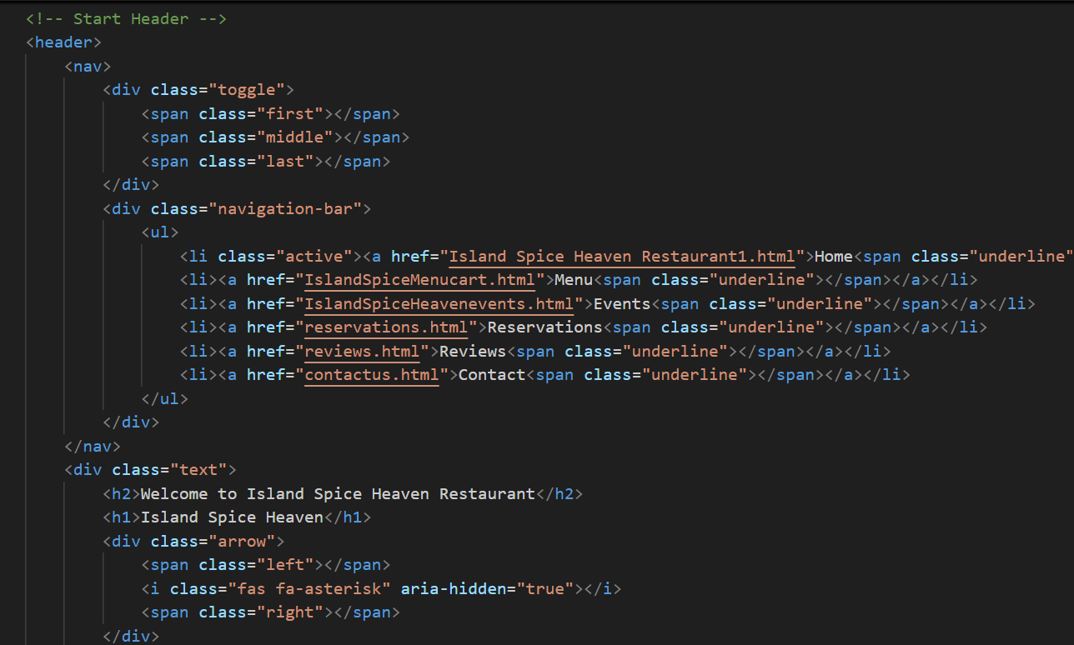
HTML5 Restaurant Homepage Content Structure:-

Slide 4
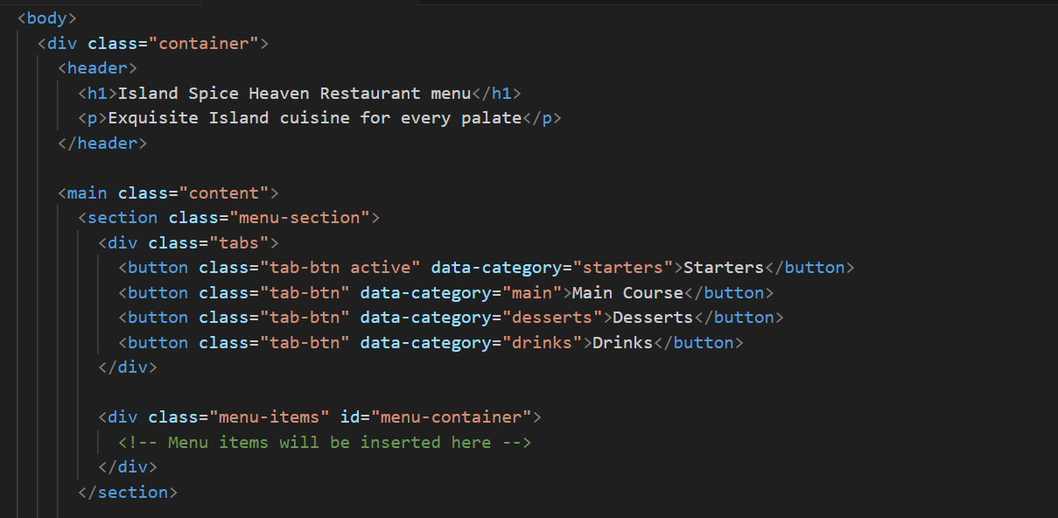
HTML5 Menu Page:-

Slide 5
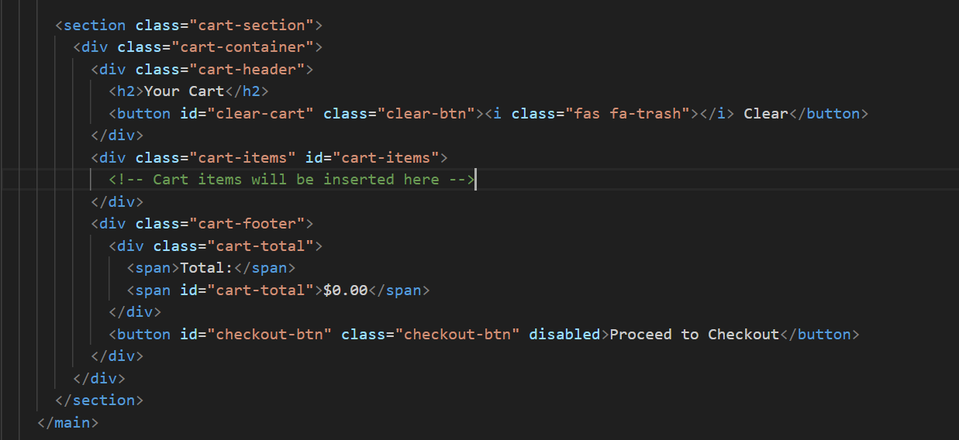
HTML5 Adding Menu Items to cart:-

Slide 6
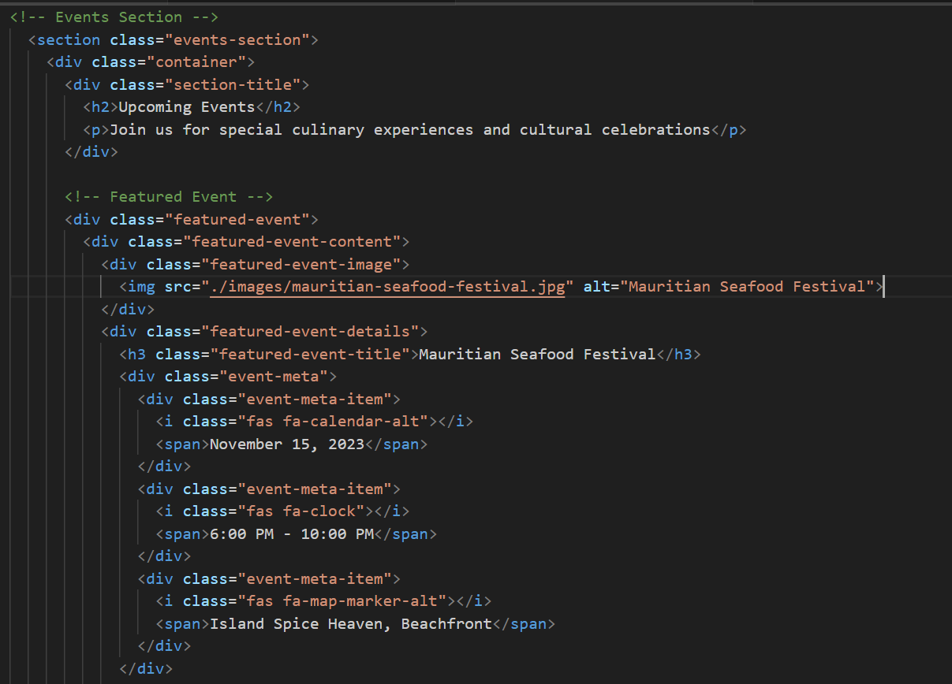
HTML5 Events Page:-

Slide 7
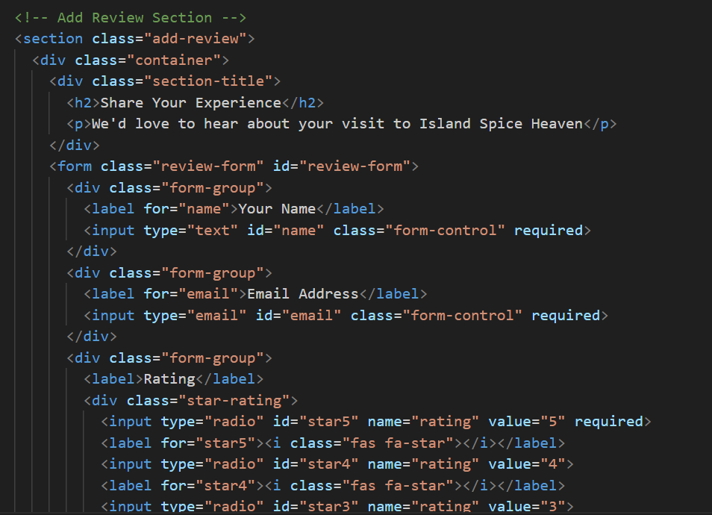
HTML5 Reviews Page:-

Slide 8
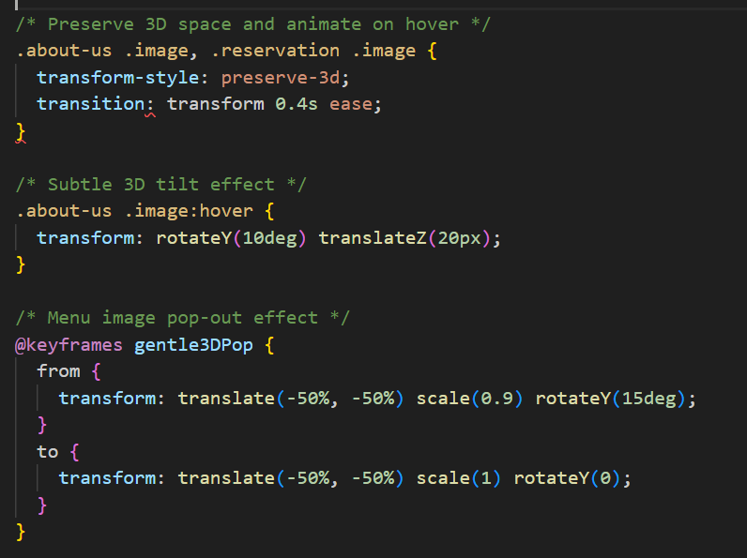
CSS3 Techniques-3D Hover Effects

Slide 9
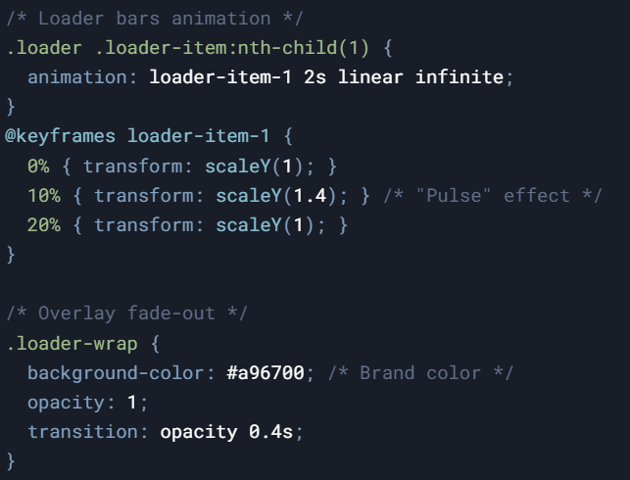
CSS3 Techniques-Animated Loader

Slide 10
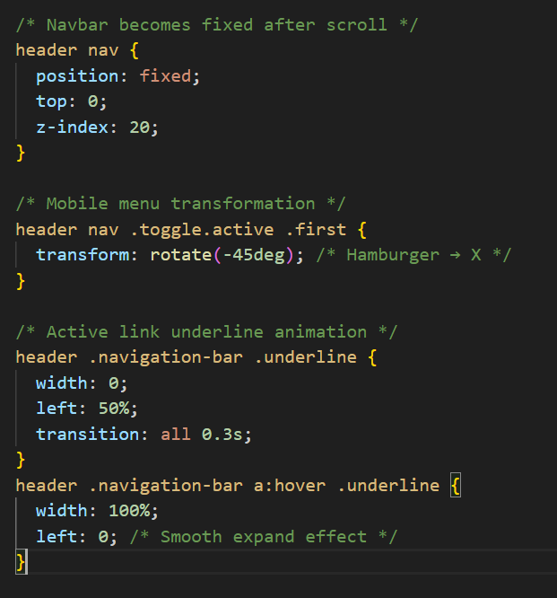
CSS3 Techniques- Dynamic Fixed Navbar

Slide 11
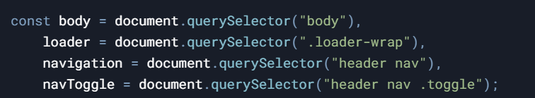
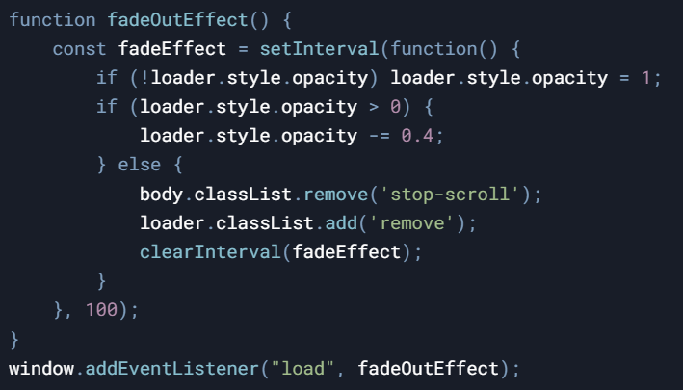
JavaScript Architecture-DOM Element using document.querySelector and Page Loader Animations :-

Slide 12

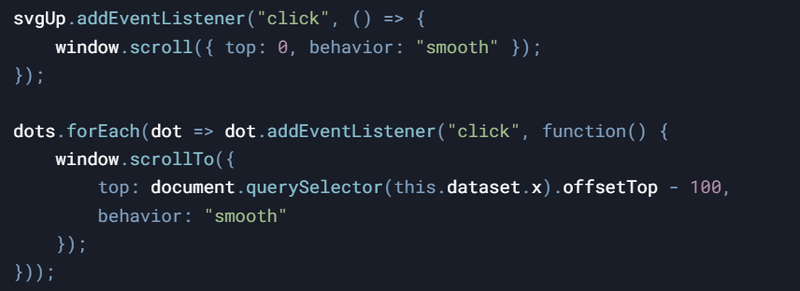
JavaScript Mobile navigation Toggle and Smooth Scroll:-

Slide 13
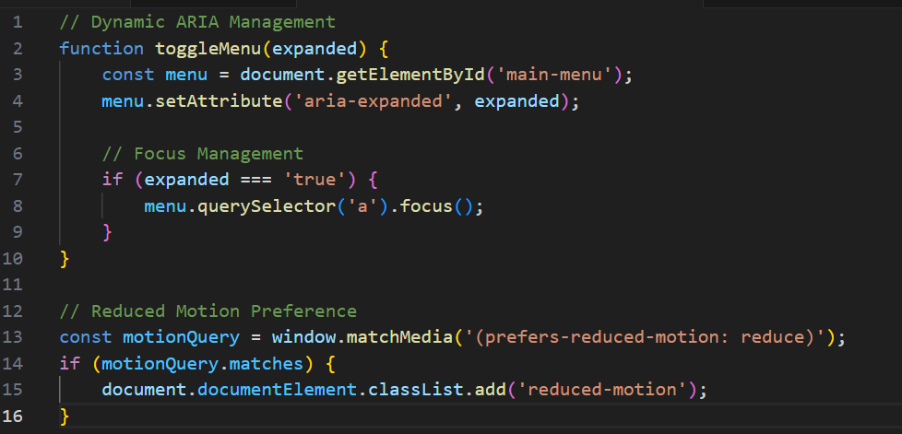
Screen Reader Optimization:

Slide 14

Island Spice Heaven Website

